Slide 1
Battle of the Books
2015-2016

Slide 2
What is Battle of the Books?
Sometimes known as B.O.B.
A book club in which teams compete by showing their knowledge of selected books.
8 pre-selected books
Teams are asked questions based on various text features:
Author and dedication
Characters and setting
Plot and themes
Teams made of students in grade 5-8, only four students per team

Slide 3
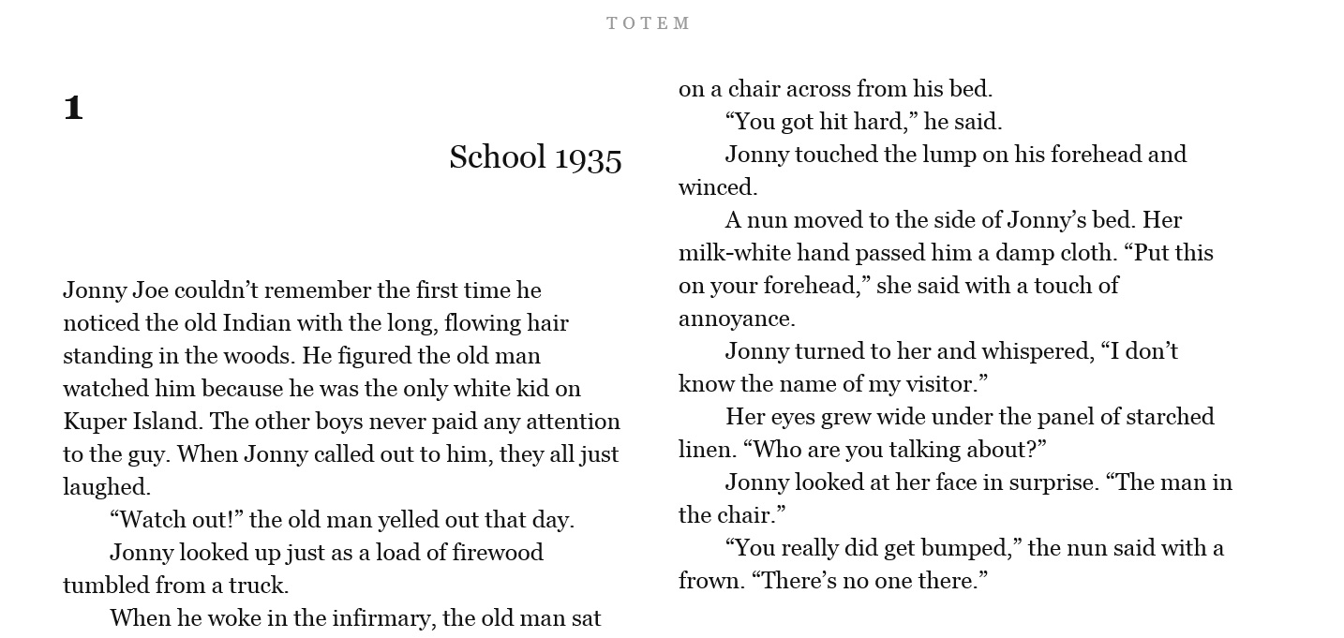
TOTEM by Jennifer Maruno
As an orphaned white boy in a school full of Native students, fourteen-year-old Jonny Joe isn’t like any of the others at the island Redemption Residential School off the west coast. When the attention of Father Gregory disturbs Jonny, he joins another boy in an escape to a mountain cave. But when they leave the cave, the world as they knew it no longer exists.

Slide 4
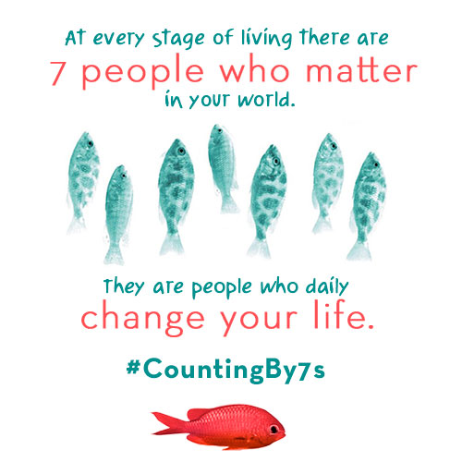
COUNTING BY SEVENS by Holly Goldberg Sloan
Twelve-year-old genius and outsider Willow Chance must figure out how to connect with other people and find a surrogate family for herself after her parents are killed in a car accident.
IL: MG BL: 5.6 AR pts: 10.0

Slide 5
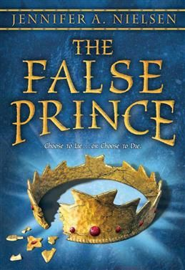
THE FALSE PRINCE by Jennifer A. Nielsen
In the country of Carthya, a devious nobleman engages four orphans in a brutal competition to be selected to impersonate the king's long-missing son in an effort to avoid a civil war. Book #1
IL: MG BL: 5.1 AR pts: 12.0

Slide 6
COLOSSUS RISES by Peter Lerangis
Teens Jack, Marco, Ally, and Cass begin a quest to find seven pieces of Atlantis’ power that were hidden long ago and that will, if returned to Atlantis, save them from death due to the genetic abnormality that also gives them superior abilities. Book #1
IL: MG BL: 4.1 AR pts: 9.0

Slide 7
CURSE OF THE DREAM WITCH by Allan Stratton
The Dream Witch haunts the forest beyond the kingdom of Bellumen, waiting to collect on a horrible debt owed by the king and queen--the heart of their only daughter, Princess Olivia. Until she has it, none of the kingdom's children are safe
IL: MG BL: 4.3 AR pts: 6.0

Slide 8
ROCKET BLUES by David Skuy
When Rocket gets cut from his AAA bantam hockey team, he needs to re-evaluate his priorities.
IL: MG BL: 4.3 AR pts: 8.0

Slide 9
AMONG THE KIDDEN by Margaret Peterson Haddix
In a future where the Population Police enforce the law limiting a family to only two children, Luke has lived all his twelve years in isolation and fear on his family's farm, until another "third" convinces him that the government is wrong.
IL: MG BL: 4.8 AR pts: 5.0

Slide 10
RED KAYAK by Priscilla Cummings
First hailed as a hero for his dramatic water rescue of a little boy, thirteen-year-old Brady soon makes a discovery that puts him at the heart of a tragedy. Alone with his dark secret, Brady is forced to choose between his friends and the right thing.
IL: MG+ BL: 4.9 AR pts: 8.0

Slide 11
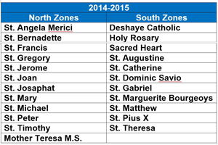
School-based Tournaments
Mid-January to March
Zones Tournaments After school 4:00 PM to 4:45 PM
Tuesday, March 1: Thursday, March 3:
St. Mary (North Zone Host) St. Bernadette(North Zone Host)
St. Theresa(South Zone Host) St. Dominic (South Zone Host)
Finals Wednesday, March 9 Miller High School

